Slide 1
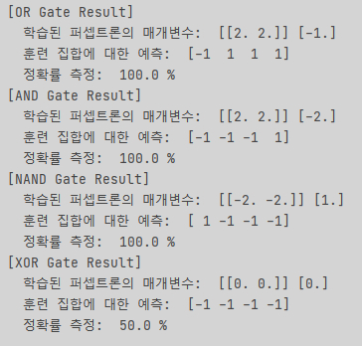

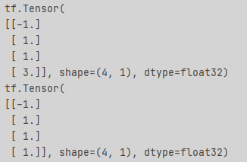
< OR Gate >
< AND Gate >
< NAND Gate >
< XOR Gate >

